Slide 1

Hoisting
What is Hoisting
JavaScript moves declarations to the top before execution.
Happens during the memory creation phase.
How It Works
var → hoisted and initialized as undefined
let & const → hoisted but not initialized (Temporal Dead Zone)
Function declarations → fully hoisted
Function expressions → hoisted only as variables
Example

Slide 2
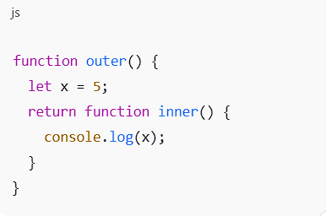
Closures
Definition
A closure is when a function remembers variables from its outer scope even after the outer function has finished.
Why Closures Work
Inner function keeps reference to outer variables
JavaScript uses lexical scoping
Simple Example

Slide 3
Practical Uses of Closures
Data hiding and encapsulation
Creating private variables
Maintaining state
Function factories
Callbacks and event handlers

Slide 4
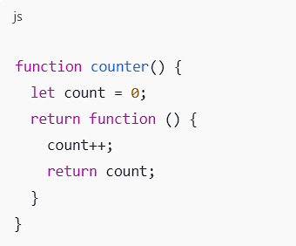
Creating Private Variables Using Closures
Concept
Variables declared inside a function cannot be accessed directly from outside.
Benefit
Prevents unwanted modification of data

Slide 5
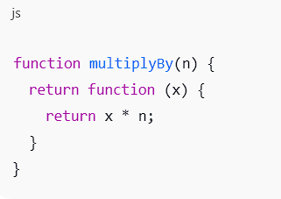
Function Factories
What is a Function Factory
A function that returns another function
Uses closures to customize behavior
Example
Use Case
Code reusability
Dynamic function creation

Slide 6
Higher-Order Functions
Definition
A function that:
Takes another function as argument OR
Returns a function
Common Examples
map()
filter()
setTimeout()

Slide 7
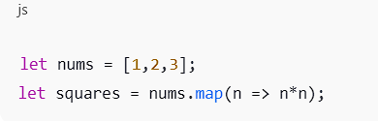
map() Function
Purpose
Creates a new array by modifying each element
Example
Key Point
Does not change original array

Slide 8
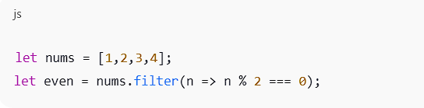
filter() Function
Purpose
Creates a new array with elements that pass a condition
Example

Slide 9
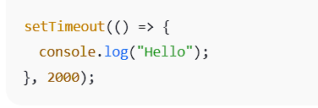
setTimeout() Function
Purpose
Executes a function after a delay
Example
Key Points
Asynchronous
Uses callbacks
Delay is in milliseconds

Slide 10
Conclusion
Hoisting affects how code is executed
Closures allow data persistence and privacy
Function factories improve reusability
Higher-order functions simplify array operations
map, filter, and setTimeout make code cleaner and efficient

